Slide 1
Docker
17-Mar-2020

Slide 2

Noticeable Challenges and Trends
AGENDA
01
Virtualization Vs Containerization
02
What is Docker
03
Need for Docker
04
Docker Architecture
05
Containers and Images
08
Docker Commands – hands on
06
07
Docker terminology
08
Docker Volumes

Slide 3
Virtual Machines(VMs)
Virtualization Technique
Advantages
App1
App2
App1
Multiple OS in same machine
Easy Maintenance and Recovery
Lower Cost
Bins
&
Libs
Bins
&
Libs
Bins
&
Libs
VMs
Guest
OS
Guest
OS
Guest
OS
Disadvantages
Hypervisor
Unstable Performance due to multiple VMs
Hypervisors not as efficient as Host OS
Long Boot-up process
Host OS

Slide 4
Containerization
Containerization is just like Virtualization at OS Level
Containerization Technique
Advantages
Containers on same OS kernel are lighter and smaller
Better Resource Utilization
Short Boot-up process
App1
App2
App1
containers
Bins
&
Libs
Bins
&
Libs
Bins
&
Libs
Container Engine
Host OS

Slide 5
What is Docker ?
Docker is a open source containerization platform from Linux academy which packages applications and all its dependencies together in the form of containers so as to ensure that the application works seamlessly in any environment be it Dev, Test , UAT or PROD
container1
container2
container3
App1
App2
App3
Bins
&
Libs
Bins
&
Libs
Bins
&
Libs
Docker Engine
Host OS

Slide 6
Docker Vs Virtual Machines

Slide 7
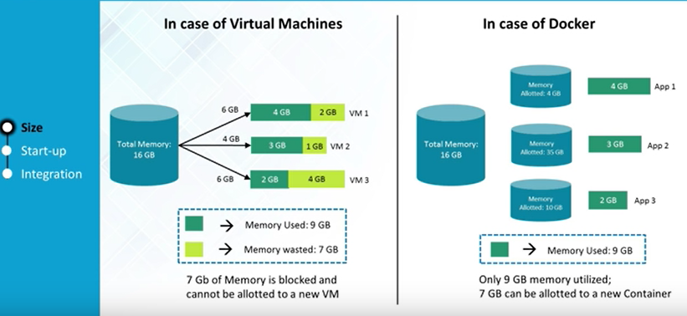
Resource & Memory Utilization

Slide 8
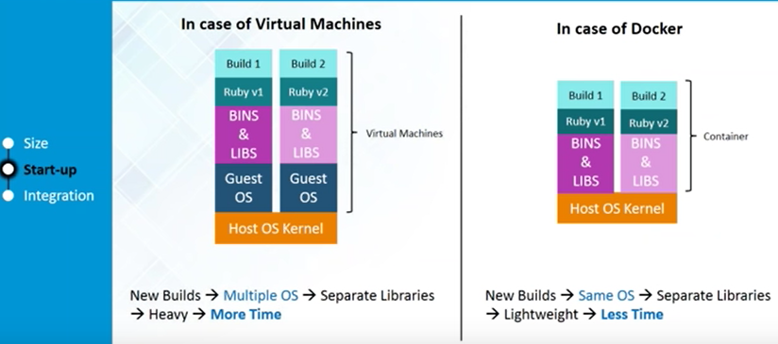
Start-up

Slide 9
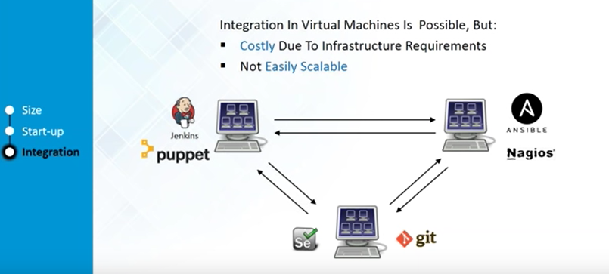
Integration in VM’s

Slide 10
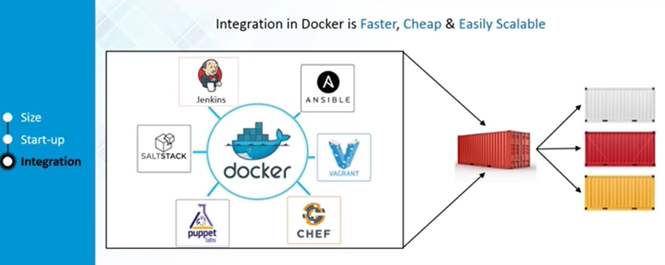
Integration in Docker

Slide 11

Why we Need Docker ?
Notes:
11

Slide 12
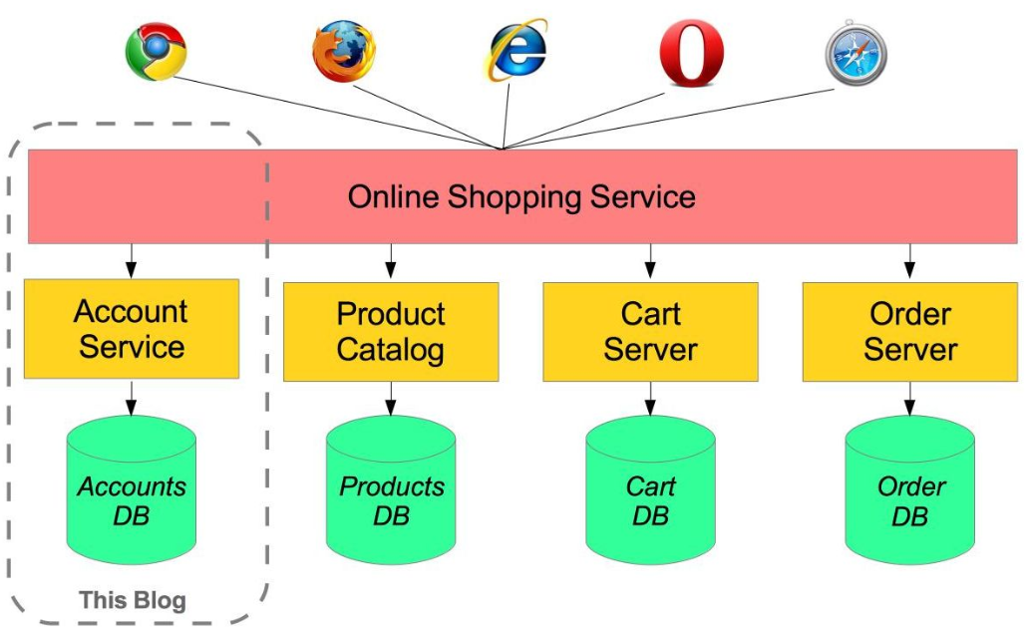
Problems Before Docker
Microservices - also known as the microservice architecture - is an architectural style that structures an application as a collection of services that are
Highly maintainable and testable
Loosely coupled
Independently deployable
Organized around business capabilities
Owned by a small team
Notes:
12

Slide 13
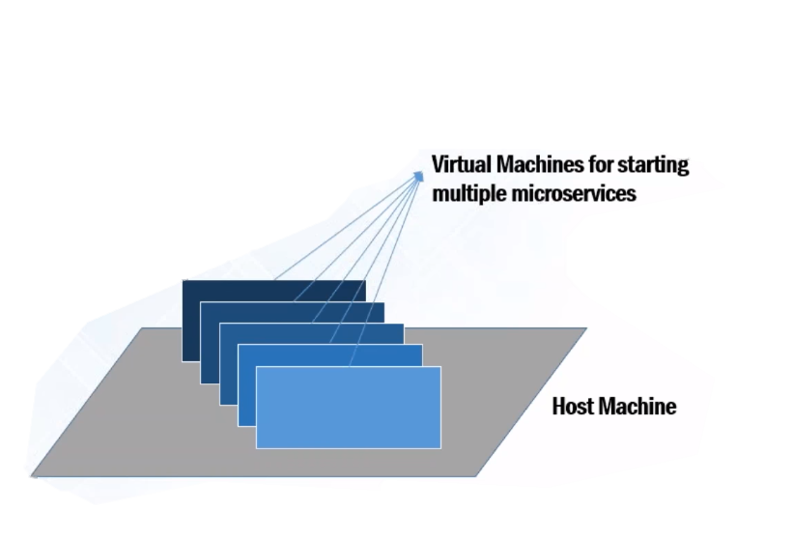

Problems Before Docker
Developing an application requires starting several microservices in one machine. For starting 5 microservices we require 5 VM’s on one particular host.
Deployable package will not have any information about required infrastructure on VM’s. Hence, Ops team must manually work on infra readiness on all VM’s prior to deployment schedule.
Notes:
13

Slide 14
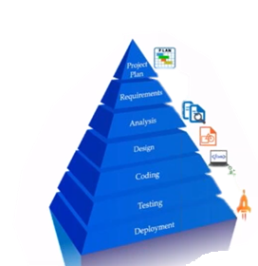
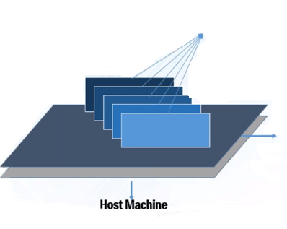
Docker Solves these Problems
Several microservices can be run in the same VM by running various docker containers for each microservice
Provides a consistent computing environment throughout SDLC lifecycle
Notes:
14

Slide 15


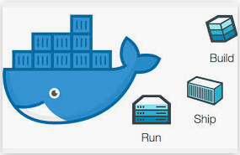
Who can use Docker ?
Docker is designed to benefit both Developers and System Administrators, making it a part of DevOps
Developers can
Write code without
worrying about
higher env
configurations
Ops Teams need
Not worry about
Infrastructure, as
Docker can easily
Scale up and
down no. of instances
OPS

Slide 16
Why Developers use Docker?
Build once…(Finally) run anywhere
A clean, safe, Hygienic and portable runtime environment for your app
No worries about missing dependencies, packages and other pain points during subsequent deployments.
Run each app in its own isolated container, so you can run various versions of libraries and other dependencies for each app.
Automate testing, integration, packaging … anything that can be scripted
Reduce\eliminate concerns about compatibility on different platforms, either your own or your customers.

Slide 17
Why DevOps Care ?
Configure once ….. Run anything
Make the entire lifecycle more efficient , consistent and repeatable
Increase the quality of code produced by developers
Eliminate inconsistency between Dev, test , uat, prod and customer environments.
Significantly improves the speed and reliability of continuous deployments and continuous integration systems
Because the containers are so lightweight, we can address significant performance, costs, deployment and portability issues normally associated with VMs.

Slide 18
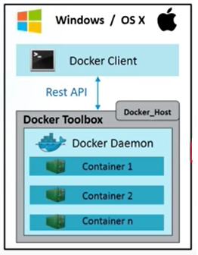
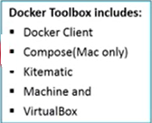
Docker Architecture – Windows OS

Slide 19
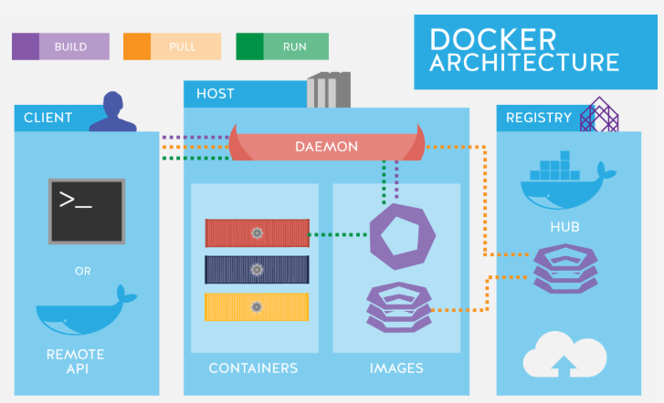
Docker Architecture

Slide 20
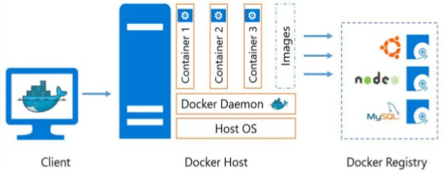
Docker Architecture(contd…)

Slide 21
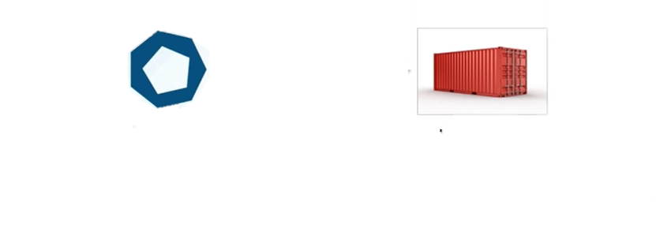
Docker Images & Docker Containers
Docker Images
Docker Containers
Read-only template used to create containers.
Built by docker users
Stored in Docker Hub or on Local registry
Isolated application platform.
Contains everything needed to run application
Built from one or more images

Slide 22
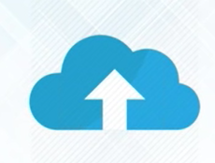
Docker Registry
Docker Registry is a storage component for Docker Images
We can store the images in Public or Private Repositories
DockerHub is docker’s very own cloud repository
Why use Docker Registry?
Control where your images are being stored
Integrate image storage with in-house development workflow

Slide 23
Docker Commands
To pull a Docker Image from the Docker registry, use the command:
$ docker pull <image_name:tag>
To run the image, use the command:
$ docker run <image_name:tag> or docker run <image_id>
To list down all the images in the local registry, use the command:
$ docker images
To login to docker hub , use the command:
$ docker login –u username –p password

Slide 24
Containers – Start & Stop
Containers can be started or stopped by running simple docker commands from terminal
We just need to specify container id or container name as parameter
To list down all the running and stopped containers , use:
$ docker ps –a
To start a container, use the command:
$ docker start <container_name>
To stop a container, use the command:
$ docker stop <container_name>

Slide 25
Deleting Containers / Images
To delete the container, use below command after stopping the container
$ docker rm <Container name>
To delete an image , use:
$ docker rmi <image id>
$ docker rmi <repo:tag>

Slide 26
Docker Terminology
Daemons run on host machine. Creates and manages Docker objects: Images, containers, volumes, networks etc. The user doesn’t directly interact with daemon, instead through the docker client.
Docker Daemon
Docker Client
Primary User Interface to Docker. It accepts commands from user and communicates back and forth with a docker daemon
Docker Images
Images are used to create Docker containers. Docker provides a simple way to build new images and update existing images. Docker images are the build component of docker.
Containers are created from Docker Images. They hold everything that is needed to run an application. Each container is an isolated and secure application platform. Docker containers are run component of Docker.
Docker Containers
Registries store images. These are public or private stores from which you upload/download images. Docker registries are distribution component of Docker
Docker Registries

Slide 27
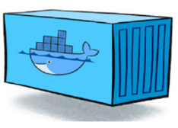
Docker System - Recap
Docker
Image
Registry
Push
Pull & Run
Pull & Run
Source
Code
Repository
Run
Dockerfile
build
Docker Engine
container
container
container
Docker
container
Docker
Host Machine
Host OS
Host OS
Staging
Prod

Slide 28


Slide 29


Slide 30
$7 BILLION | 110,000 EMPLOYEES | 31 COUNTRIES

